Slide 1


A DATA-DRIVEN APPROACH TO CROP SELECTION USING SOIL HEALTH AND FOOD PRICE DATA
Guided by,
Dr.R.Nallakumar M.E, MBA, Ph.D.,
Associate Professor,
Department of Artificial Intelligence and Data Science,
Karpagam Institute of Technology,
Coimbatore.
Presented by
S.ARCHANA (721220243003),
S.LINKEDH (721220243028),
M.PRASANTH(721220243045),
K.SRIKANTH(721220243053),
Department of Artificial Intelligence and Data Science,
Karpagam Institute of Technology,
Coimbatore.

Slide 2
ABSTRACT
This research introduces a data-driven framework for suggesting suitable plants by analyzing soil health and food prices. It aims to enhance agricultural decision-making by integrating these factors.
Through data collection, preprocessing, and feature engineering, a predictive model is developed, correlating soil attributes and market costs with plant performance. This model aids in identifying optimal crops for specific locations. By omitting the user interface aspect, the focus remains on technical aspects.
The project holds potential for optimizing crop choices, leading to improved agricultural yield and economic outcomes.

Slide 3
OBJECTIVE
Optimizing Productivity: Use soil health and food price data to inform crop selection, maximizing yields efficiently and meeting the demands of a growing population through data-driven decision-making in agriculture.
Enhancing Profitability: Integrate food price trends into crop selection, ensuring economic viability for farmers by aligning cultivation choices with market demand for increased income and sustainable farming practices.
Promoting Sustainability: Utilize soil health data for sustainable agriculture, reducing reliance on chemicals, preserving soil fertility, and aligning economic prosperity with environmental stewardship for long-term farming sustainability.

Slide 4
LIMITATIONS OF EXISTING SYSTEM
Lack of Data-Driven Insights: The current agricultural system relies heavily on traditional knowledge and experience, often resulting in suboptimal crop choices. Without harnessing the power of data analytics, farmers miss out on valuable insights into soil health and market trends, leading to inefficiencies in crop selection and reduced profitability.
Limited Integration of Soil Health Metrics: Soil health indicators significantly impact crop outcomes, yet the existing system often lacks comprehensive integration of these metrics. Farmers might not have access to real-time data on soil composition, fertility, and moisture levels, leading to uninformed decisions and potentially lower yields.
Market-Blind Cultivation: Farmers often lack up-to-date information on food market dynamics, including fluctuating prices and shifting consumer preferences. This disconnect between cultivation and market demand results in situations where crops may be grown in excess or not enough, leading to wastage and financial losses.

Slide 5
PROPOSED SYSTEM
Support Vector Machine and Decision Trees Combination:
Combining Support Vector Machine and decision trees leverages regression's ability to capture linear relationships between soil metrics and crop yields, while decision trees handle non-linear patterns in market demand and economic factors. This ensures a more comprehensive understanding of crop performance and desirability.
Holistic Recommendations:
The integrated approach provides holistic recommendations by assessing both agronomic factors (yield prediction from Support Vector Machine) and economic factors (demand prediction from Decision trees). This results in well-rounded crop suggestions that align with both soil health and market dynamics.
Interpretability and Practicality:
Decision trees offer transparent decision paths, making it easier for farmers to understand why certain crops are recommended based on market trends. This transparency enhances user trust and aids in making practical, informed planting decisions, promoting sustainable and profitable agriculture.

Slide 6
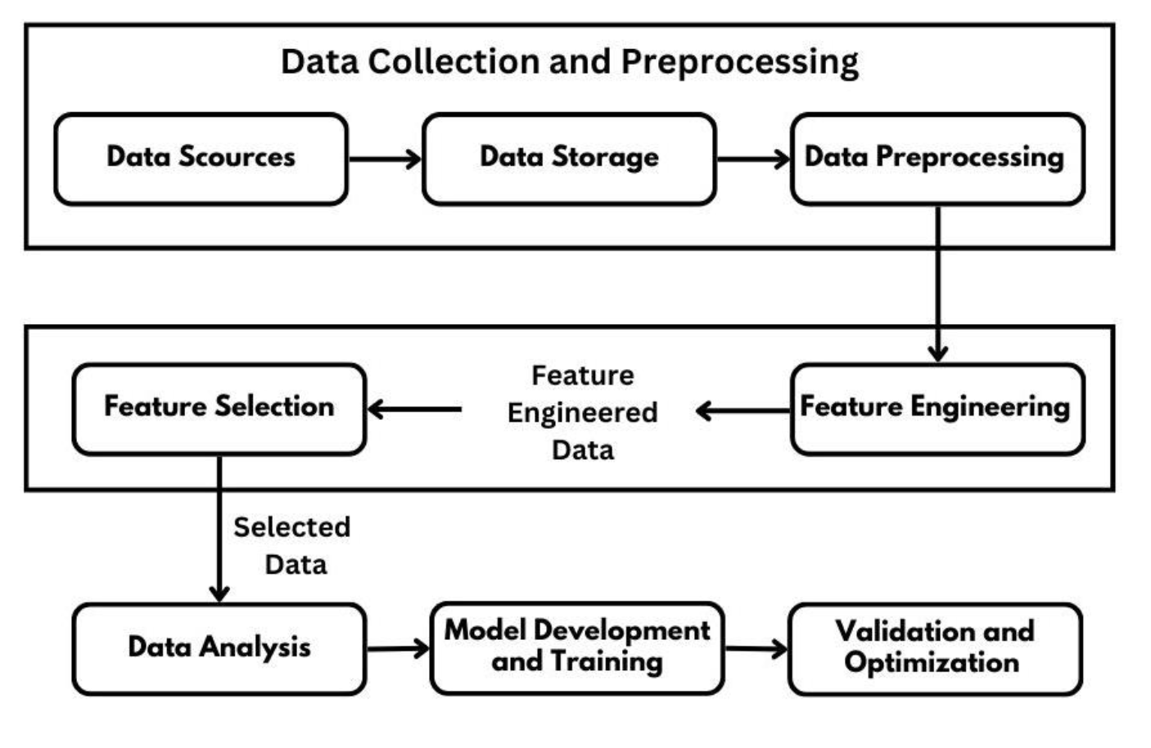
OVERALL ARCHITECTURE OF SYSTEM

Slide 7
MODULES IDENTIFIED
Data Collection and Preprocessing (Module 1)
Feature Engineering and Selection Module (Module 2)
Model Development and Training Module
(Module 3)
Validation and Optimization Module (Module 4)

Slide 8
Module Description for the Data Collection and Preprocessing Module
The "Data Collection and Preprocessing" module involves gathering soil health and food price data, ensuring its accuracy through cleaning and integration.
The data is then transformed into a consistent format and stored for subsequent analysis.
This module lays the foundation for building a predictive model by providing high-quality, structured data that encompasses both soil characteristics and market costs.

Slide 9
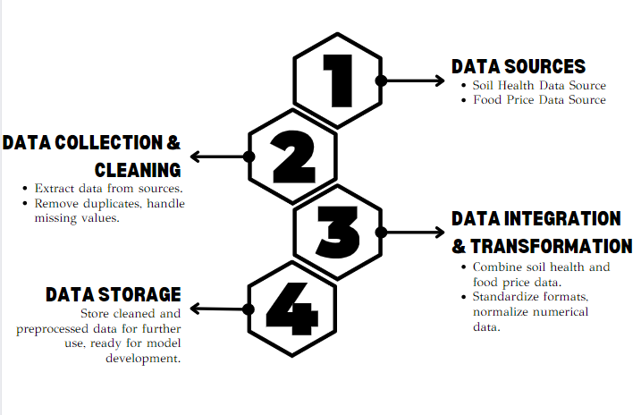
Data Flow Diagram for Data Collection and Preprocessing Module Module

Slide 10
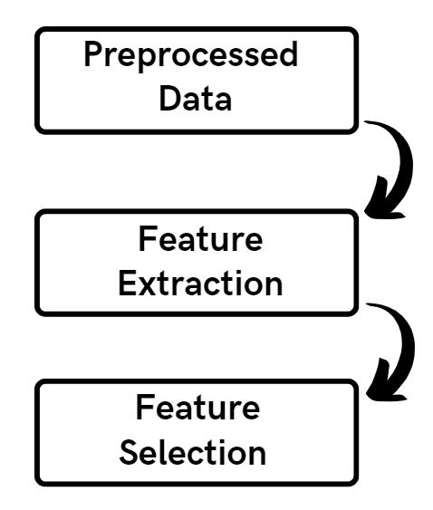
DFD and Module Description for the Feature Engineering and Selection Module
The "Feature Engineering and Selection" module refines data for model development. Relevant features are identified from the integrated data, such as nutrient levels and pH. Unnecessary attributes are removed, and if required, new features are generated.
The resulting dataset forms the basis for training the predictive model, ensuring that only the most impactful and meaningful features are considered in the analysis.

Slide 11
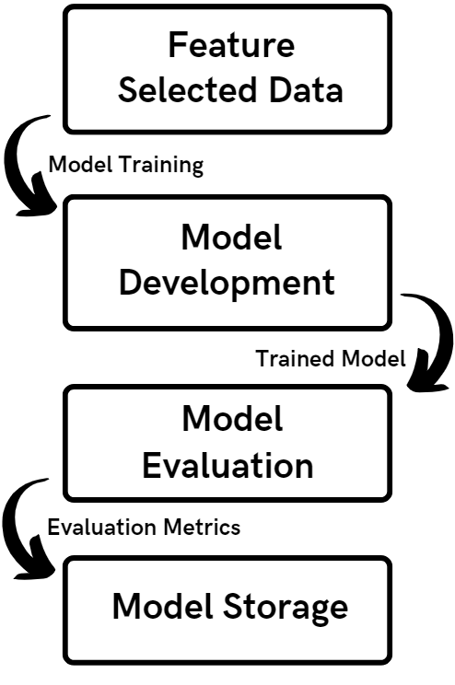
DFD and Module Description for the Model Development
The "Model Development and Training" module creates a predictive model using machine learning techniques. It employs the refined dataset to establish correlations between soil health, food prices, and plant growth.
The model undergoes training using historical data, learning patterns and relationships. By utilizing advanced algorithms, the module enables the model to make accurate predictions about optimal plant choices based on soil characteristics and market conditions.

Slide 12
Module Description for the Validation and Optimization
The "Validation and Optimization" module validates and fine-tunes the predictive model to ensure accuracy and reliability. It involves assessing the trained model's performance against historical data. If necessary, optimization techniques are applied to adjust model parameters, algorithms, or feature selections, improving predictive precision.
This iterative process ensures the model aligns with real-world outcomes and enhances its effectiveness in offering actionable recommendations.
The module's outcome is a refined and validated predictive model that provides trustworthy insights for plant suggestions based on soil health and food prices.

Slide 13
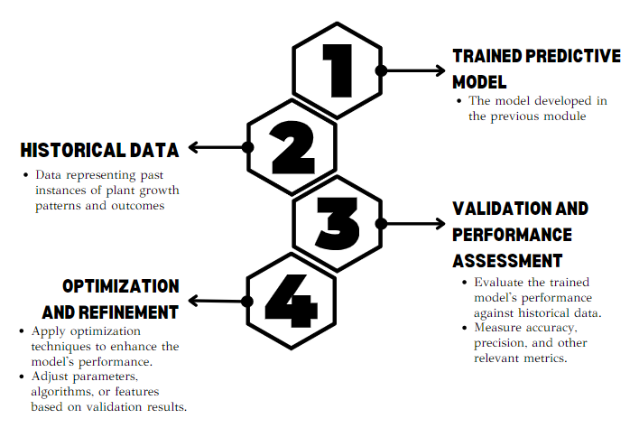
DFD for Validation and Optimization Module

Slide 14
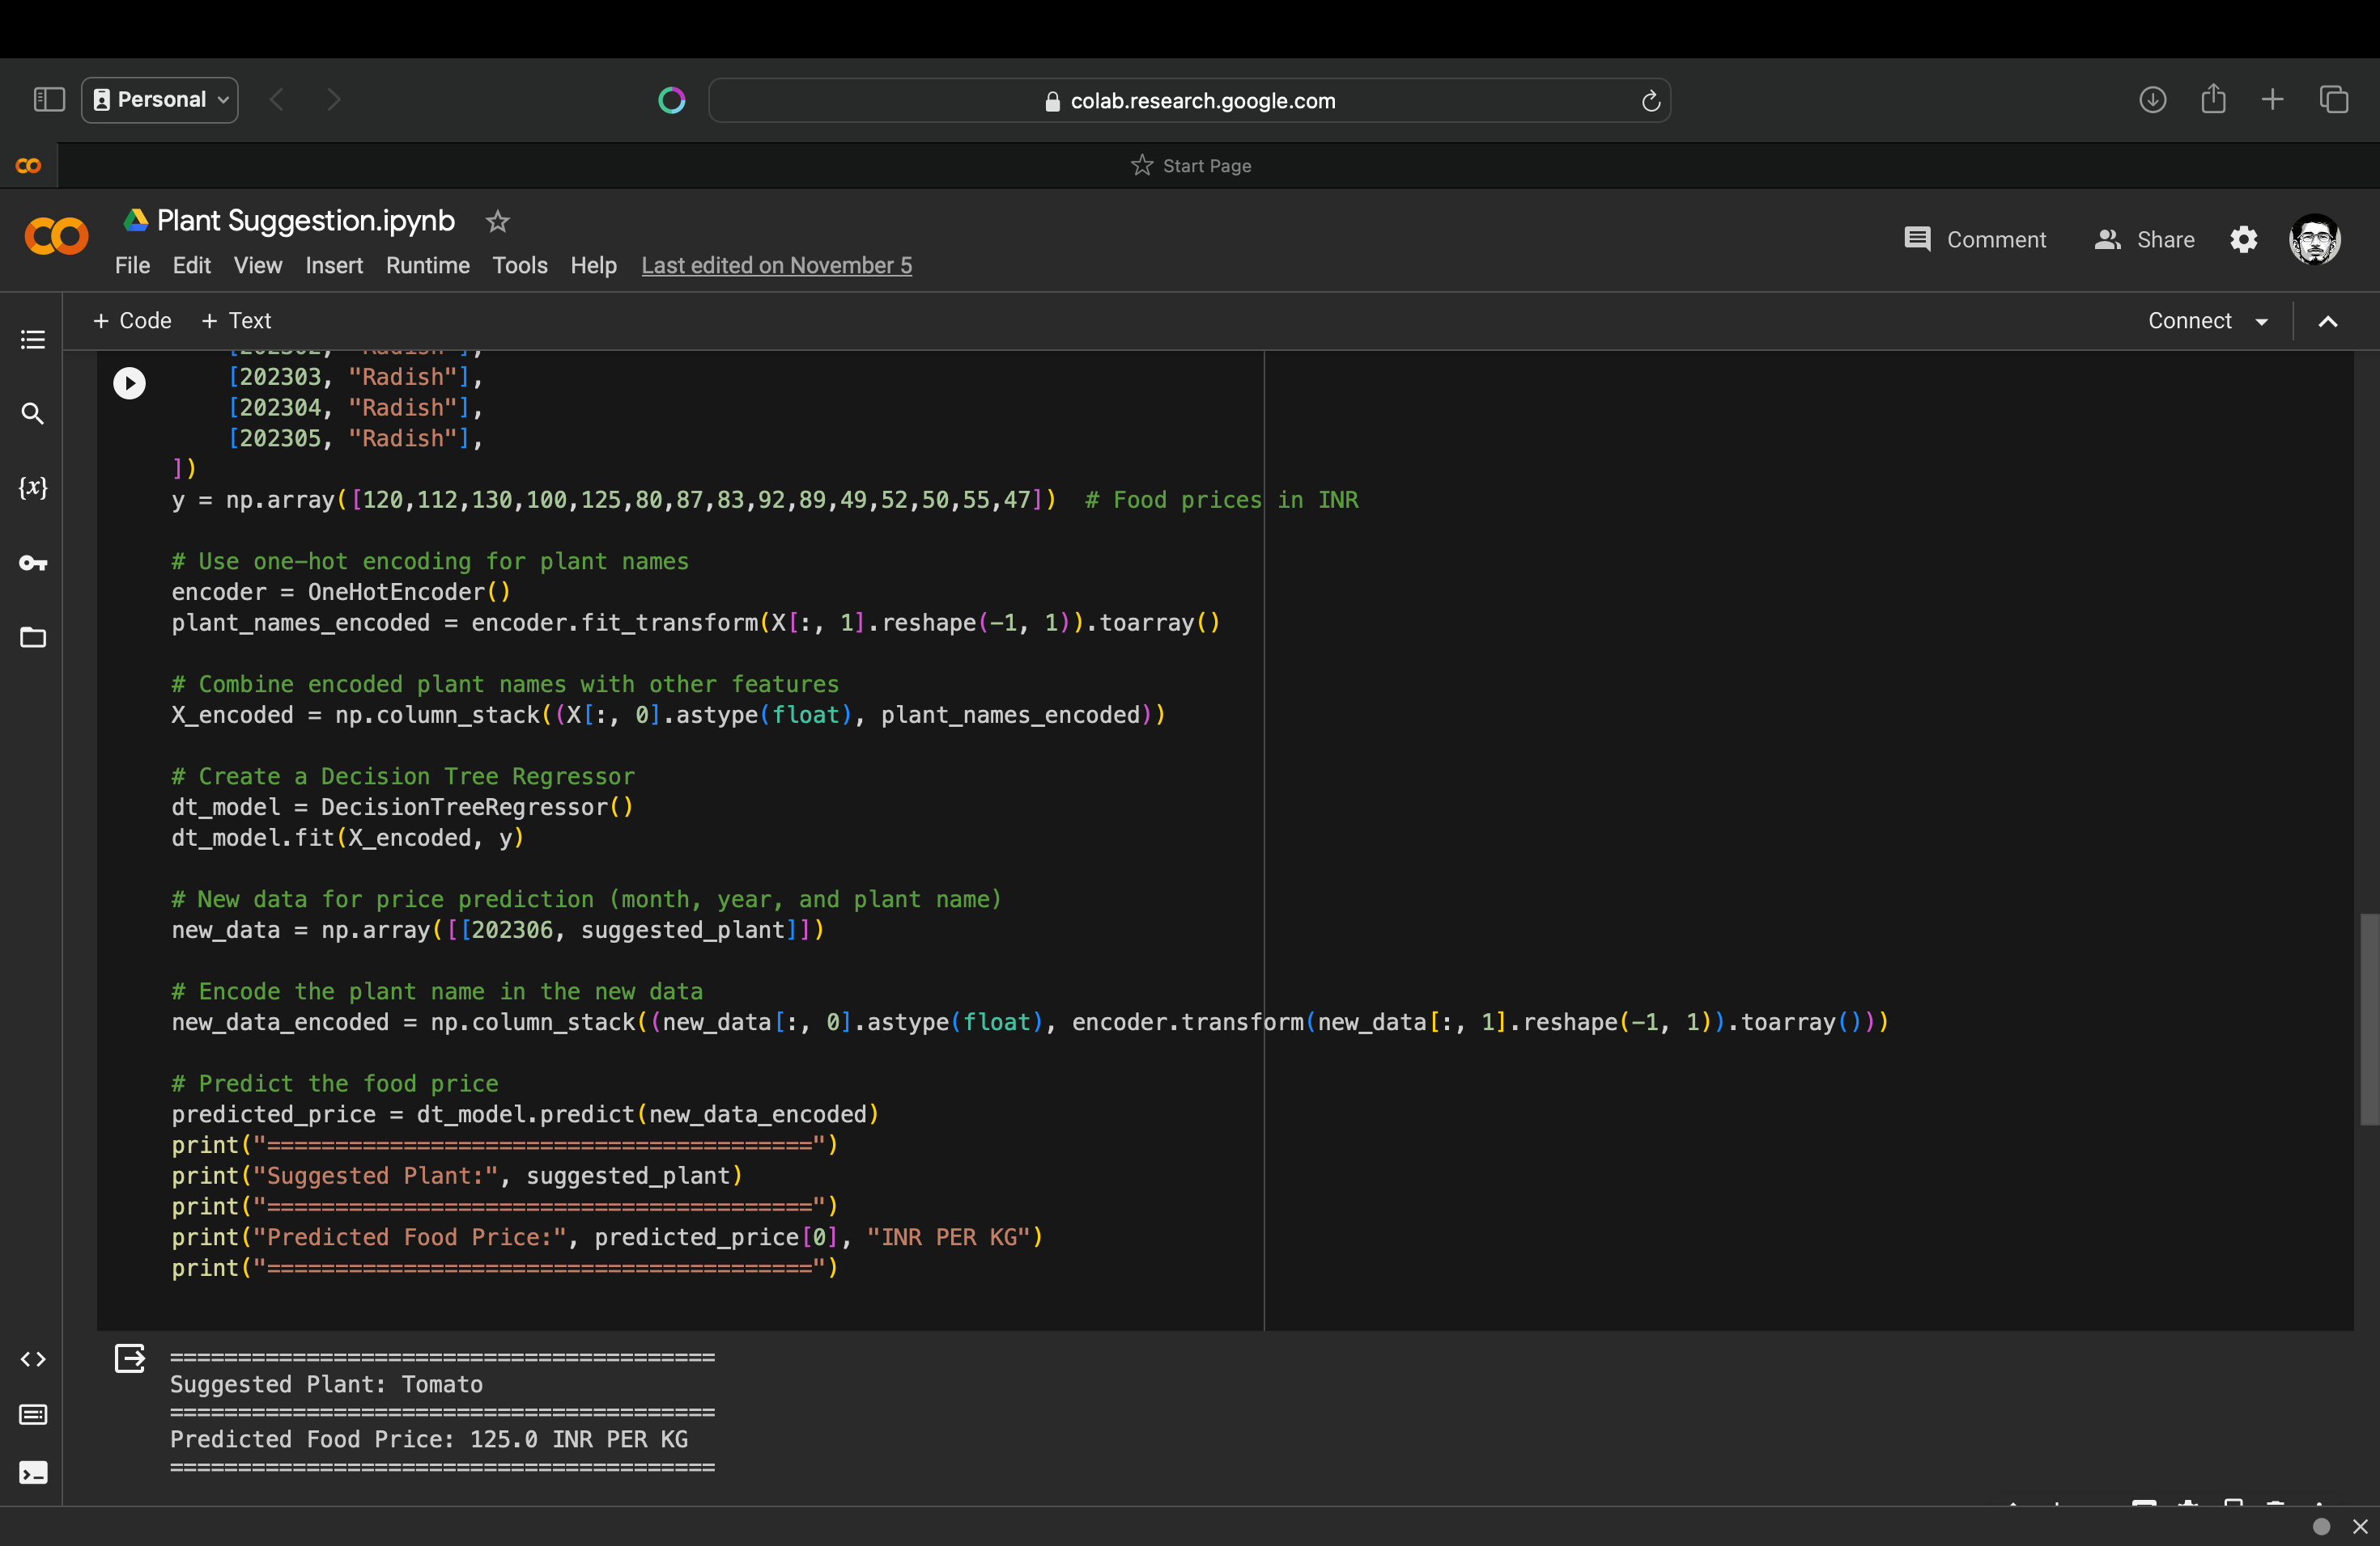
SAMPLE SOURCE CODE

Slide 15
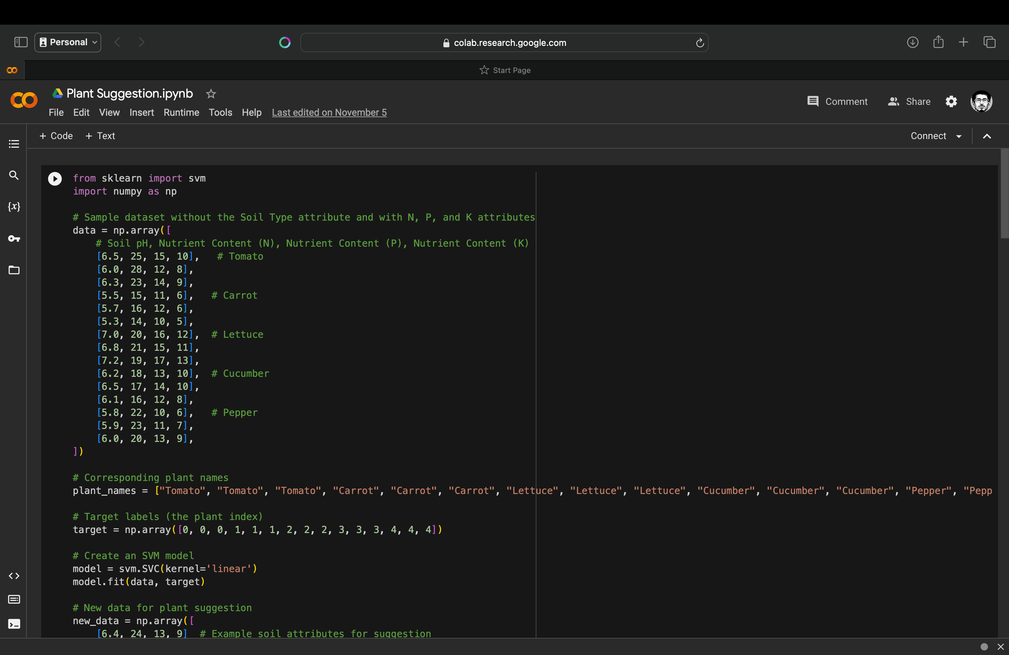
SAMPLE SOURCE CODE

Slide 16
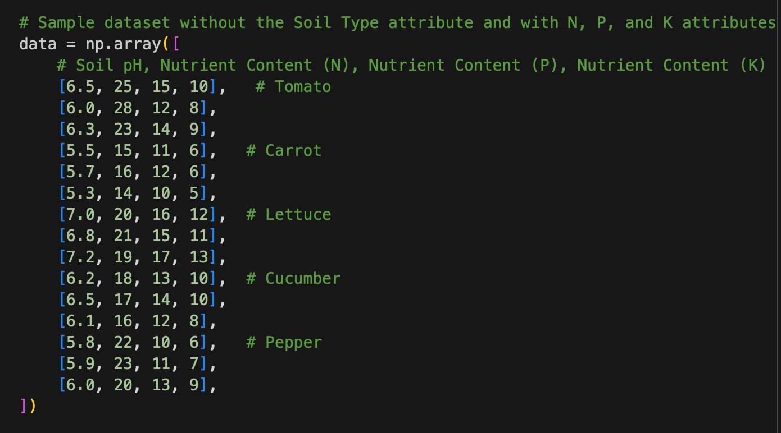
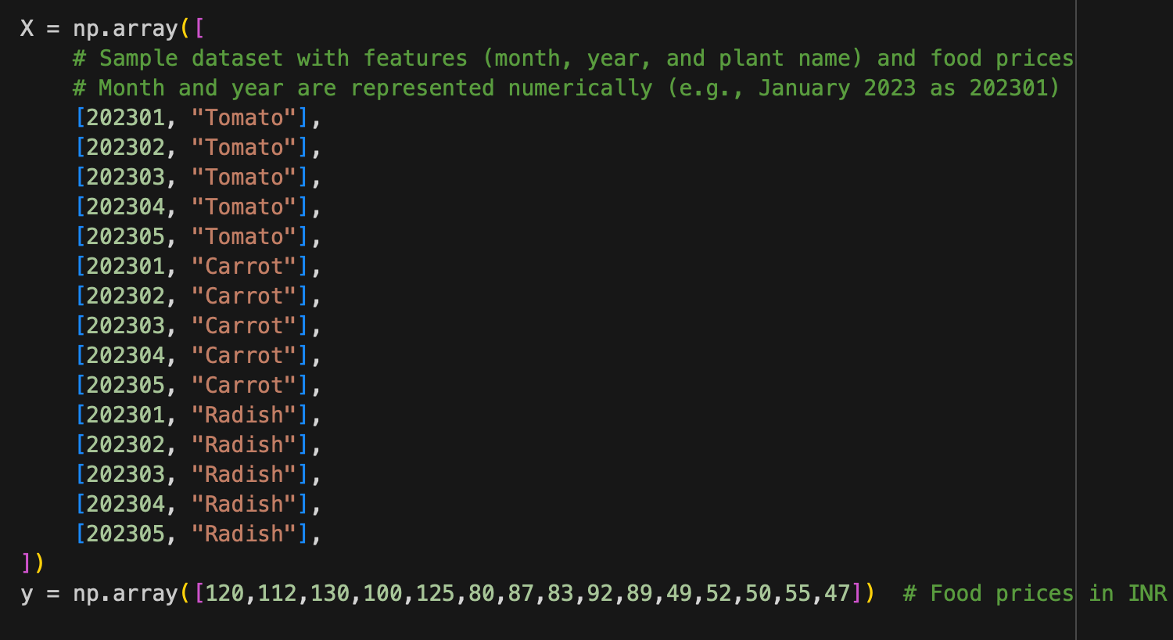
IMPLEMENTATION SCREENSHOTS
Input Dataset for Training the Model
The input data comprising various plant features like sunlight exposure, water needs, soil pH, temperature range, and growth habits. Each plant is represented as a data point with these features as attributes.

Slide 17
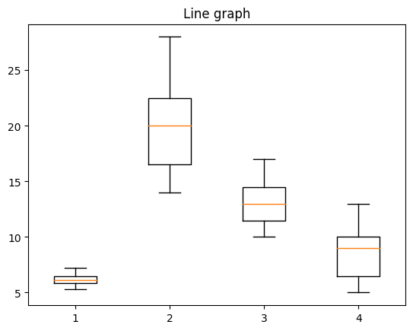
IMPLEMENTATION SCREENSHOTS
Analysis of Soil Health Data
Box plots are invaluable tools for analyzing soil health data across various parameters, including Soil pH, Nutrient Content (N, P, and K). These plots offer a concise an informative representation of data distribution, enabling soil scientists and agricultural experts to gain insights into the key statistics and variations within these essential soil properties.

Slide 18
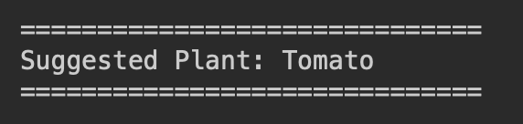
IMPLEMENTATION SCREENSHOTS
Output of Phase 1 – Plant Suggestion
In Phase 1 of the plant suggestion process, the initial step involves a thorough analysis of soil data to suggest appropriate plant selections based on soil characteristics. This entails a comprehensive evaluation of key factors, including soil pH and nutrient content (N, P, K), to ascertain the soil's compatibility with various plant types. Recommendations are formulated by aligning these soil attributes with the specific preferences of different plant species.

Slide 19
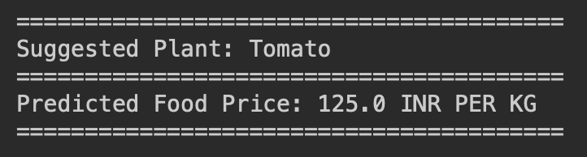
IMPLEMENTATION SCREENSHOTS
Output of Phase 2 – Plant suggestion with Price using Historical Data
Phase 2 of the plant suggestion process harnesses historical data to further enrich recommendations, introducing price considerations into the equation. The system delves into past pricing data for the suggested plant varieties, accounting for seasonal fluctuations and market dynamics. This phase goes beyond evaluating soil suitability alone, providing users with a more holistic perspective on plant choices by factoring in the cost dimension.
This approach ensures a well-rounded and practical approach to successful gardening or agricultural planning, where considerations of soil conditions and financial limitations are harmoniously balanced, enabling users to achieve their objectives while managing their resources judiciously.

Slide 20
References
Jenskie Jerlin I. Haban , John Carlo V. Puno
Soil Fertilizer Recommendation System using Fuzzy Logic
2020 IEEE REGION 10 CONFERENCE (TENCON)
Pradeepta Kumar Sarangi; Deepti Sinha; Sachin Sinha; Neetu Mittal
Machine Learning Approach for the Prediction of Consumer Food Price Index
2021 9th International Conference on Reliability, Infocom Technologies and Optimization (Trends and Future Directions) (ICRITO)
Kartika CanFatima A.S Binofai; Maha O. A Mohamad;Mustapha D. Ibrahim
SWOT-4Ps analysis of UAE Organic food market
2022 Advances in Science and Engineering Technology International Conferences (ASET)
Juliana Ngozi Ndunagu; Helen Aderemi; Joseph Bamidele Awotunde
Time Series: Predicting Nigerian Food Prices using ARIMA Model and R-Programming
2022 5th Information Technology for Education and Development (ITED)
Yufei Zhao; Chao Huang; Jiebo Luo
How to Prepare for the Next Pandemic - Investigation of Correlation Between Food Prices and COVID-19 From Global and Local Perspectives
2022 IEEE International Conference on Big Data (Big Data)

Slide 21
THANK YOU!

